Slide 1

Literature, Standards, and Patent Search Presentation
By:
Ian Adelman
Devin Hoopes
Natalie Gonzalez
Alex Reinert
Notes:
Ian slide

Slide 2





Agenda
Introduction
Statistics and Data
Standards and Codes
Existing Designs
Questions
2
Notes:
Ian Slide

Slide 3





Meet the Team
Ian Adelman
System Engineer
Devin Hoopes
System Engineer
Natalie Gonzalez
Team Lead
Alex Reinert
System Engineer
3
Notes:
Ian Slide

Slide 4
Review of the Problem Statement
Transporting heavy furniture up or down one flight of straight stairs is difficult and potentially dangerous.
4
Notes:
Natalie Slide

Slide 5

Cost of Injury [1]
Between 1990 and 1998:
20.5 Million days of work were lost due to Musculoskeletal Disorders (MSD’s)
2.6 Billion dollars were lost (in 1998 dollars)
~8.5 Billion in today’s dollars
5
Notes:
Devin Slide

Slide 6
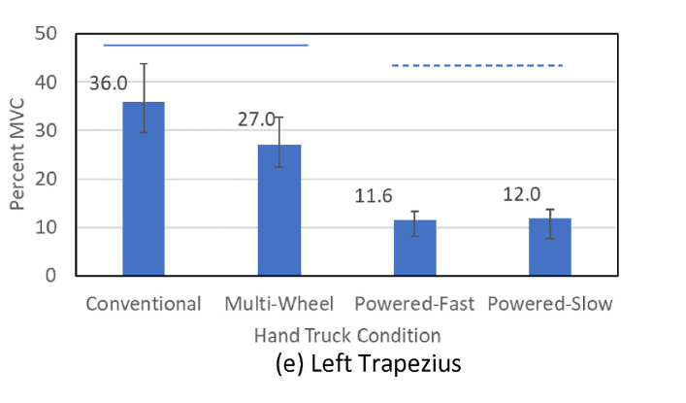
Benefits of Powered Hand Trucks [2]
Powered devices require three times less energy than a conventional hand truck
6
Notes:
Devin Slide

Slide 7


Minimum Stair Dimensions [3]
Section R311.7.1 Width:
The minimum stair width is between 36 and 27 inches, depending on handrail configuration
Minimum Width of 36 Inches
7
Notes:
Ian Slide

Slide 8
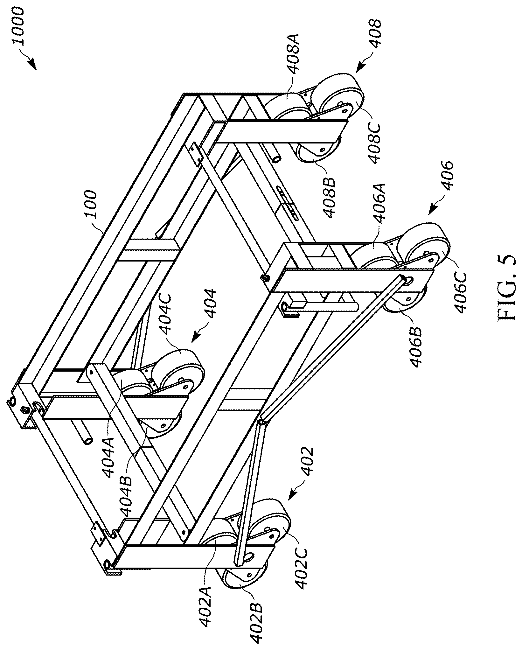

Existing Designs: Casket Stair Climber [4]
This invention was designed to move caskets up and down the stairs. It uses a “trolley frame” with four sets of a 3-wheel system to move up and down the stairs.
Trolley Frame
From this design, we can take how they moved the casket up and down the stairs. The 3-wheel system itself rotates as a combined system to move up each step.
3-Wheel System
The Stair Climber for Caskets, Patent No. US11691660B2
8
Notes:
Alex Slide

Slide 9
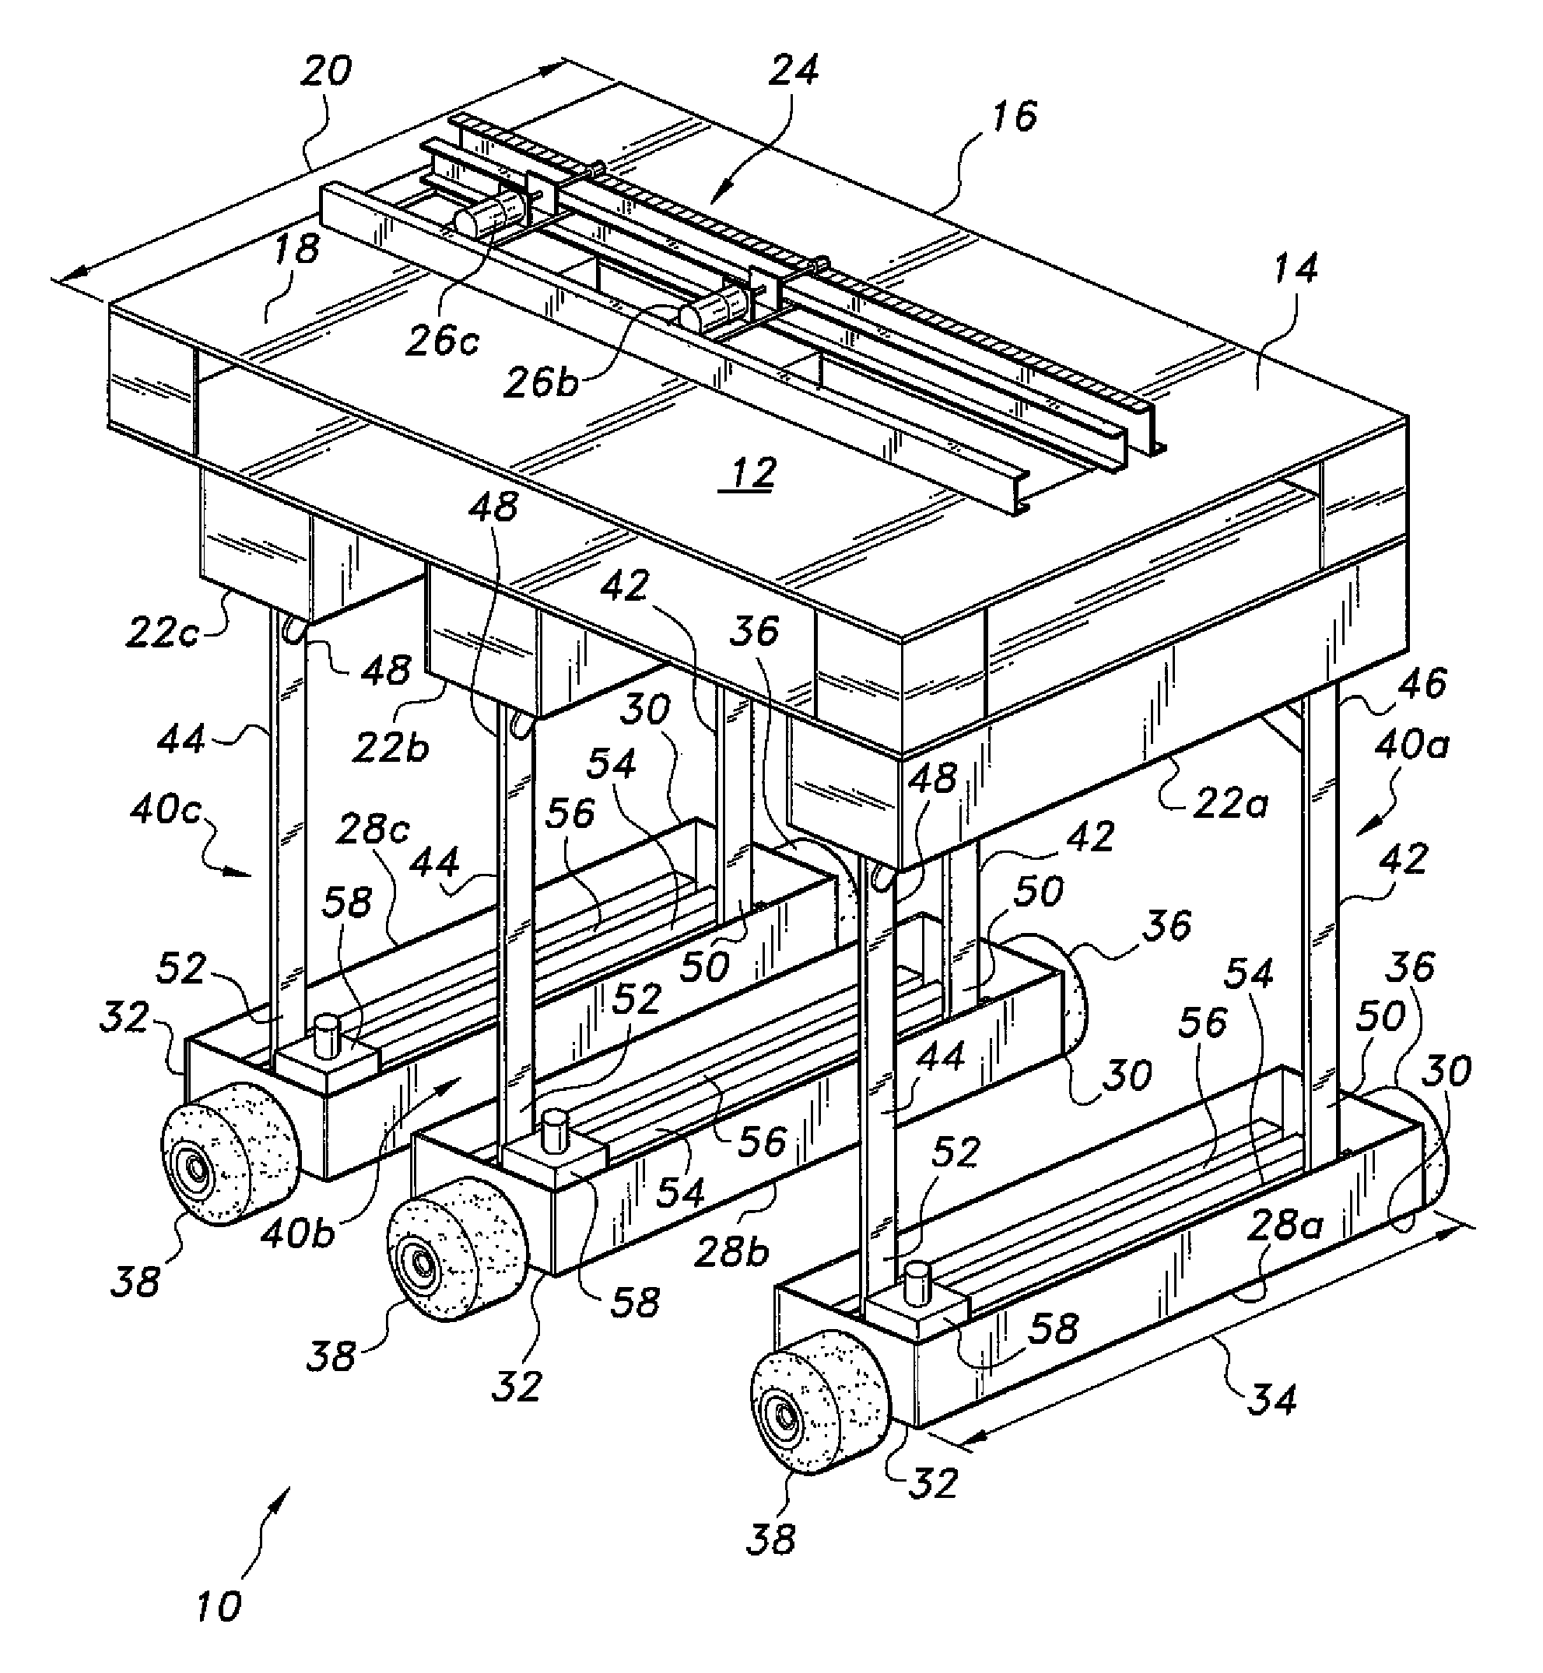
Existing Designs: Stair-Climbing Apparatus [5]
This patent was designed to move objects up the stairs using three wheels that move horizontally and vertically.
Stair-Climbing Apparatus, Patent No. US8776917B2
9
Notes:
Alex Slide

Slide 10
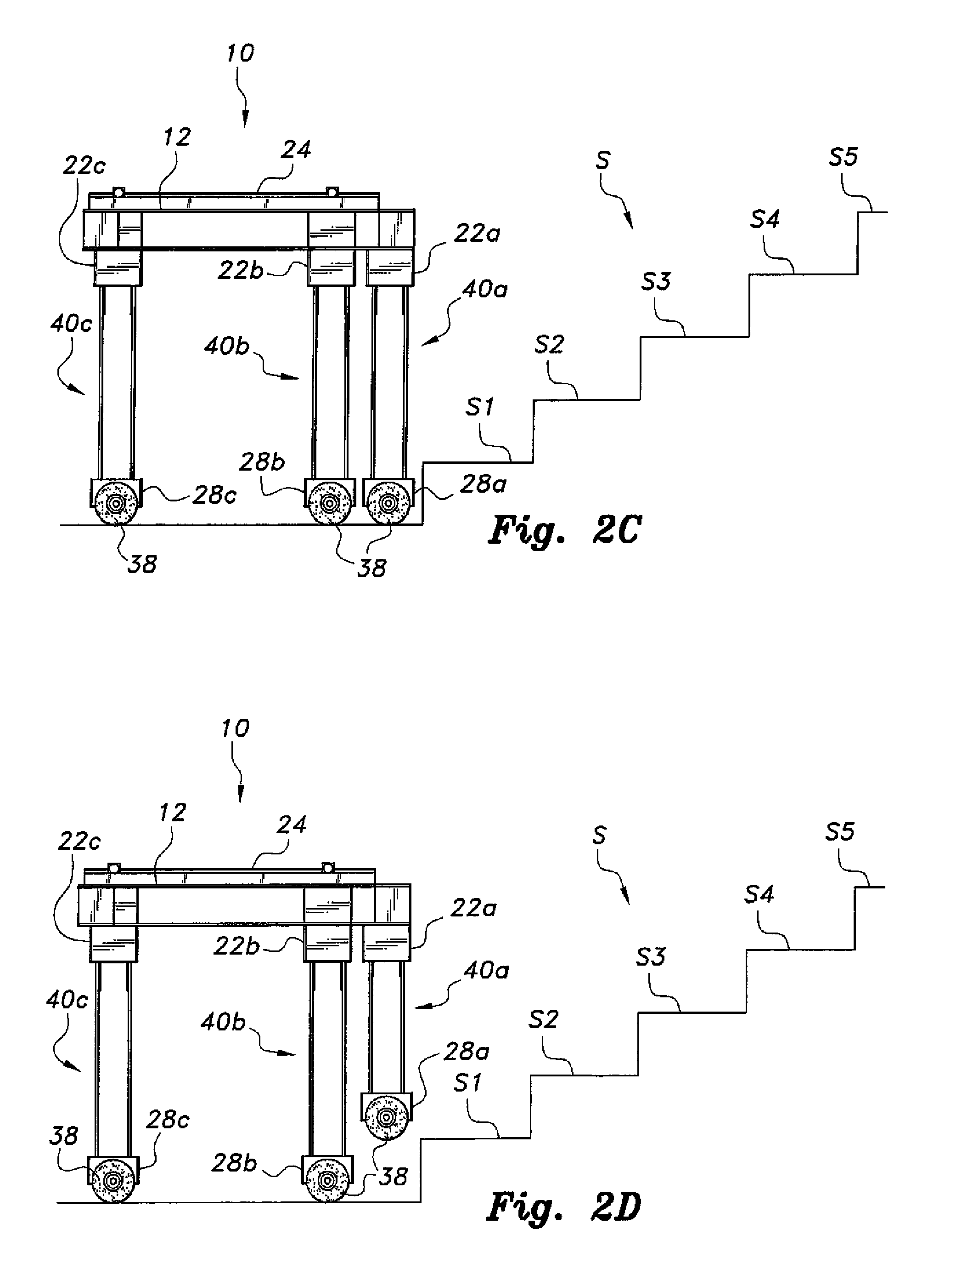
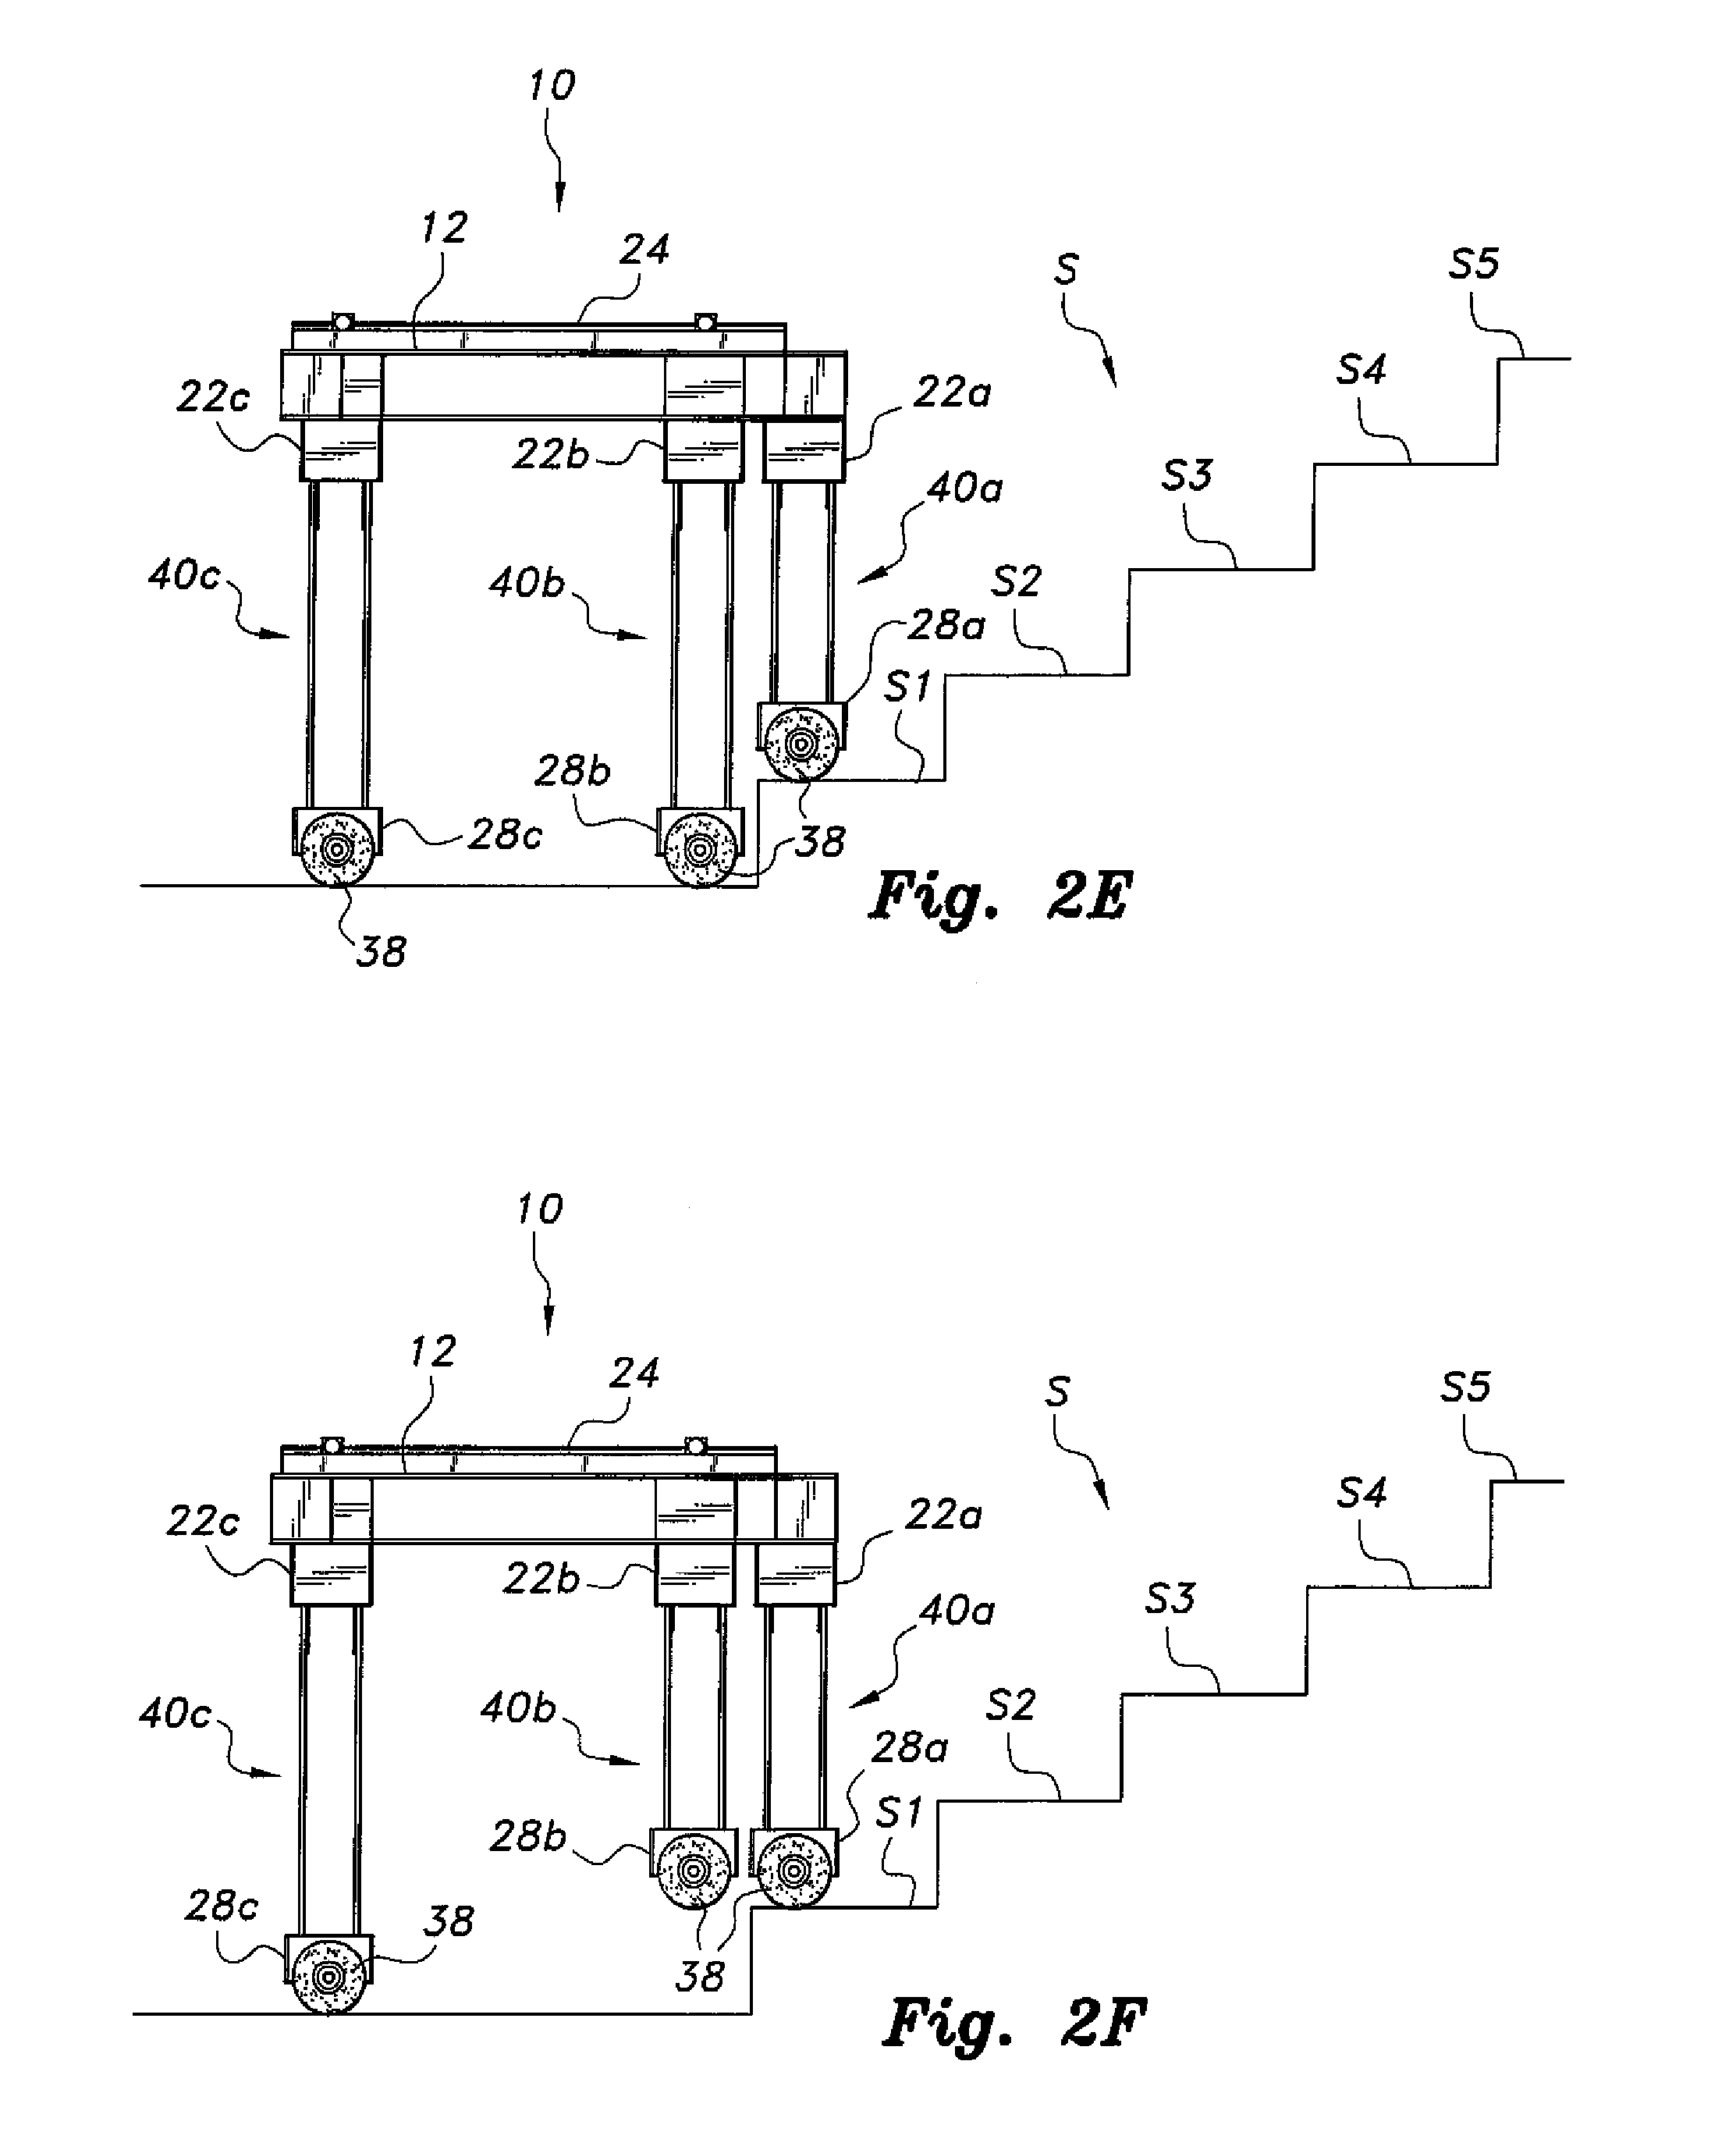
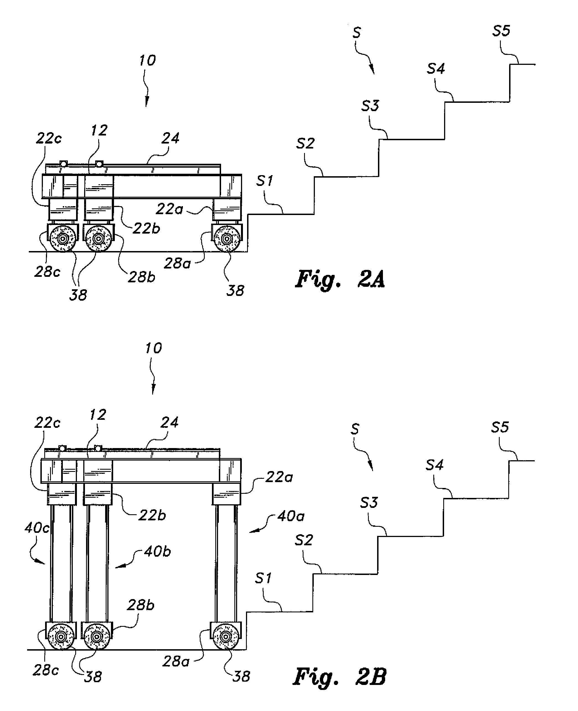
Existing Designs: Stair-Climbing Apparatus [5]
The Stair-Climbing Apparatus is useful because it is a motorized way to move up and down the stairs.
10
Notes:
Alex Slide

Slide 11
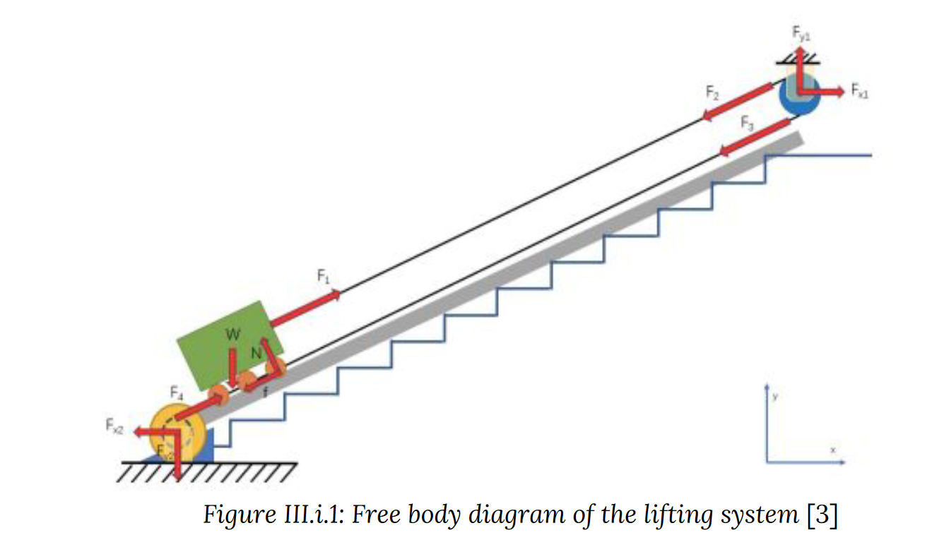
Existing Designs: Portable Stair Lift System [6]
The Portable Stair Lift was designed by Madison Brown, Ethan Peters, Chenxi Li, Robert Peralta, and Mingzhang Zhu.
The system is designed to move objects up and down the stairs using a pulley, a winch, and motors. It uses a rail system to make sure the object is aligned going up and down the stairs.
Pulley
Rail
Winch
Stair-Climbing Apparatus, Patent No.
11
Notes:
Natalie Slide

Slide 12
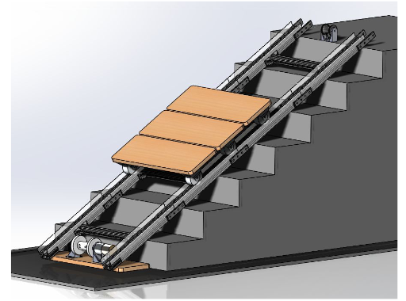
Existing Designs: Portable Stair Lift System [6]
The Portable Stair Lift provides another solution to the problem compared to an autonomous system by using a pulley and a winch to move the payload up or down the stairs and rail system that guides the payload up or down the stairs.
Portable Stair Lift System
12
Notes:
Natalie Slide

Slide 13

Questions?
13

Slide 14
References
[1]
B. Silverstein, E. Viikari-Juntura, and J. Kalat, “Use of a prevention index to identify industries at high risk for work-related musculoskeletal disorders of the neck, back, and upper extremity in Washington state, 1990–1998,” American Journal of Industrial Medicine, vol. 41, no. 3, pp. 149–169, 2002, doi: 10.1002/ajim.10054.
[2]
S. A. Lavender, J. Charbonnet, and C. M. Sommerich, “Biomechanical assessment of alternative hand trucks for transporting heavy loads up and down stairs,” Applied Ergonomics, vol. 110, p. 104010, Jul. 2023, doi: 10.1016/j.apergo.2023.104010.
[3]
“CHAPTER 3 BUILDING PLANNING, 2021 International Residential Code (IRC) | ICC Digital Codes.” https://codes.iccsafe.org/content/IRC2021P1/chapter-3-building-planning (accessed Sep. 15, 2023).
[4]
Palumbo JR., Samuel, “Stair Climber for Casket,” US11691660B2, Jul. 04, 2023 Accessed: Sep. 14, 2023. [Online]. Available: https://patents.google.com/patent/US11691660B2/en?q=(stair+climber)&oq=stair+climber
[5]
A. Bouhraoua, N. Merah, J. Al-Muaybid, A. A. Sayoud, A. Al-Darweesh, and J. J. Al-Dawoud, “Stair-climbing apparatus,” US8776917B2, Jul. 15, 2014 Accessed: Sep. 13, 2023. [Online]. Available: https://patents.google.com/patent/US8776917B2/en?oq=us8776917b2
[6]
M. B. ME, “Portable Stair Lift System,” PhD Thesis, WORCESTER POLYTECHNIC INSTITUTE, 2021.
14

